Slide 1

Chapter 27
Next Generation:
IPv6 and ICMPv6
Objectives
Upon completion you will be able to:
Understand the shortcomings of IPv4
Know the IPv6 address format, address types, and abbreviations
Be familiar with the IPv6 header format
Know the extension header types
Know the differences between ICMPv4 and ICMPv6
Know the strategies for transitioning from IPv4 to IPv6

Slide 2
27.1 IPv6
IPv6 has these advantages over IPv4:
1. larger address space
2. better header format
3. new options
4. allowance for extension
5. support for resource allocation
6. support for more security
The topics discussed in this section include:
IPv6 Addresses
Address Space Assignment
Packet Format
Comparison between IPv4 and IPv6

Slide 3
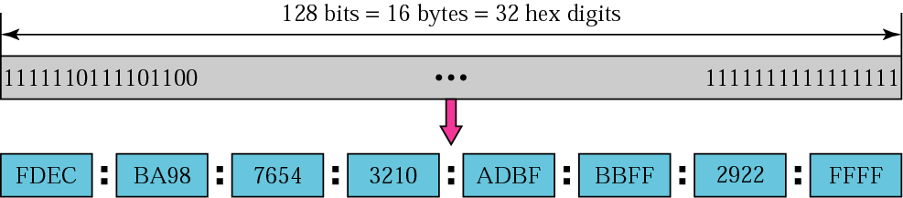
Figure 27.1 IPv6 address

Slide 4
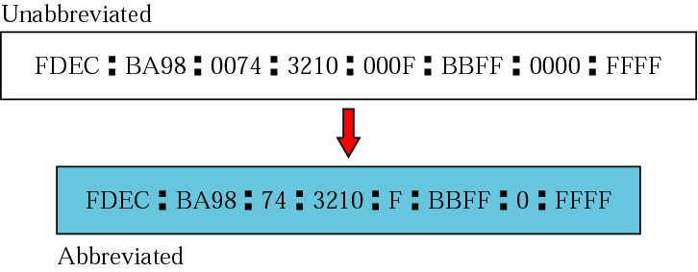
Figure 27.2 Abbreviated address

Slide 5
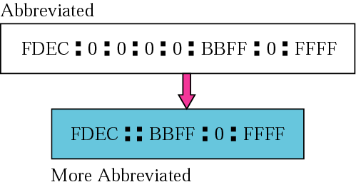
Figure 27.3 Abbreviated address with consecutive zeros

Slide 6

Figure 27.4 CIDR address

Slide 7
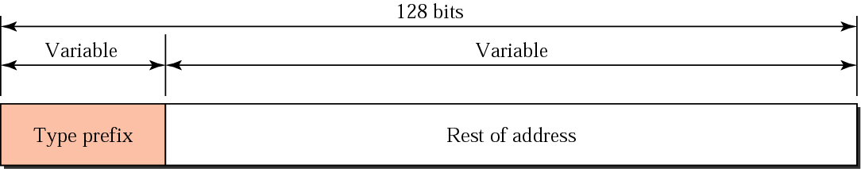
Figure 27.5 Address structure

Slide 8
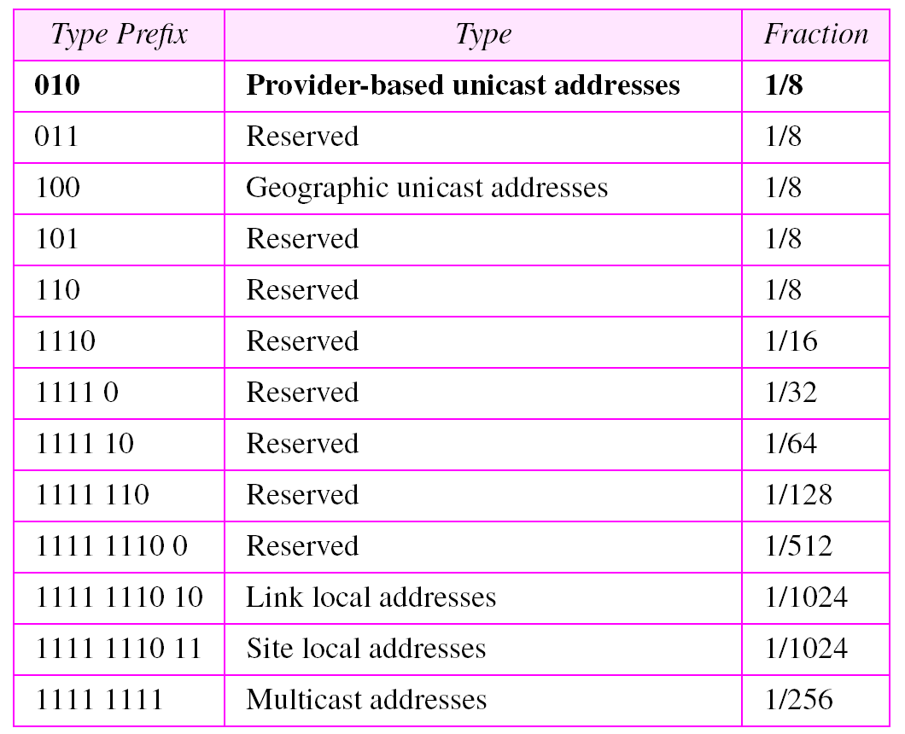
Table 27.1 Type prefixes for IPv6 addresses

Slide 9
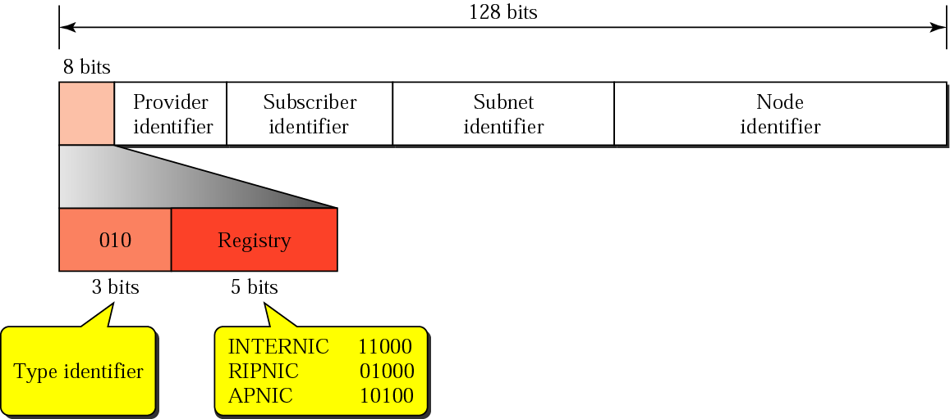
Figure 27.6 Provider-based address

Slide 10
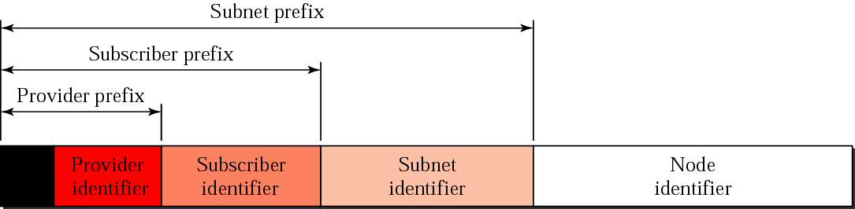
Figure 27.7 Address hierarchy

Slide 11

Figure 27.8 Unspecified address

Slide 12

Figure 27.9 Loopback address

Slide 13
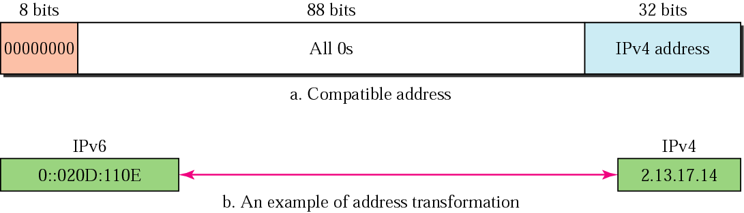
Figure 27.10 Compatible address

Slide 14
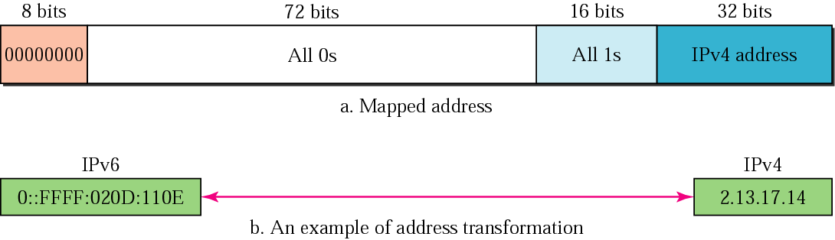
Figure 27.11 Mapped address

Slide 15
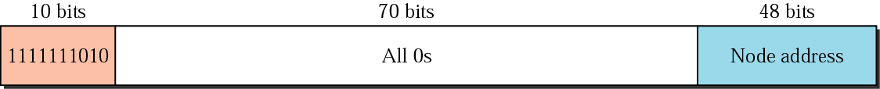
Figure 27.12 Link local address

Slide 16
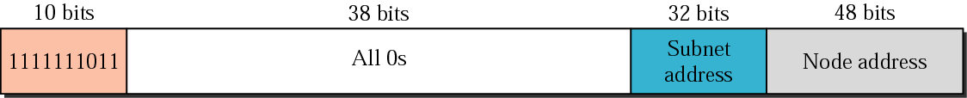
Figure 27.13 Site local address

Slide 17
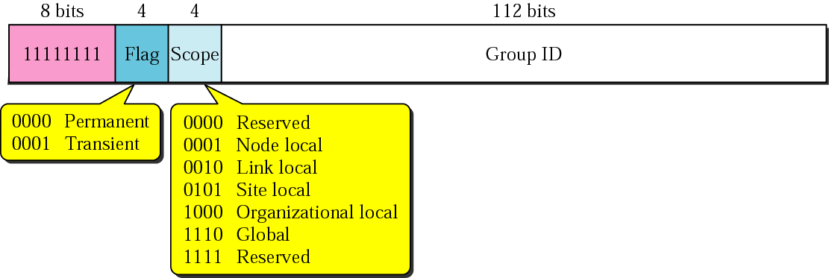
Figure 27.14 Multicast address

Slide 18
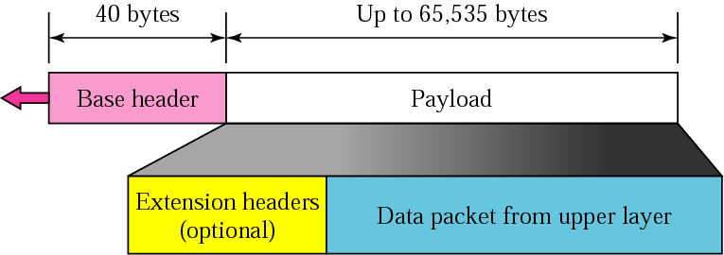
Figure 27.15 IPv6 datagram

Slide 19
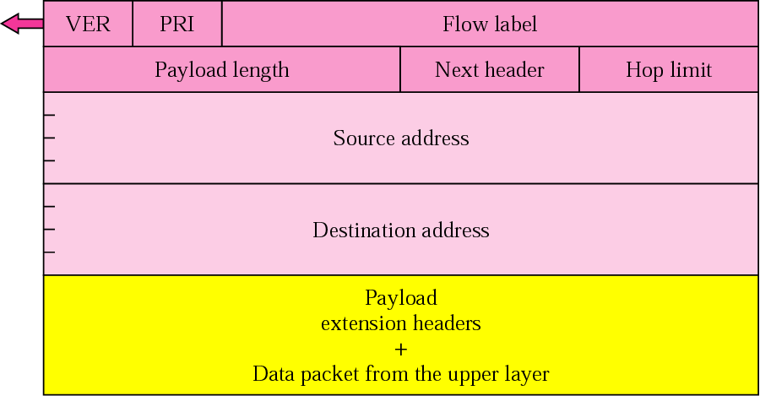
Figure 27.16 Format of an IPv6 datagram

Slide 20
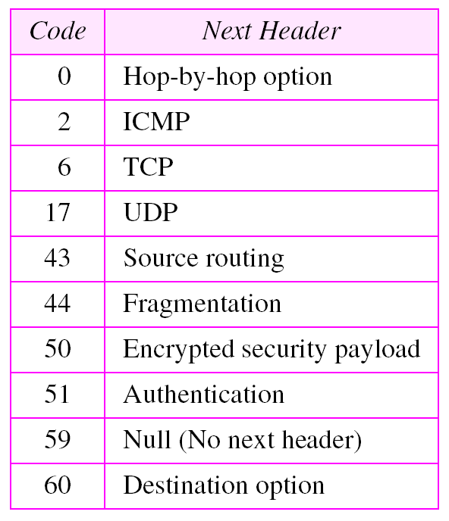
Table 27.2 Next header codes

Slide 21
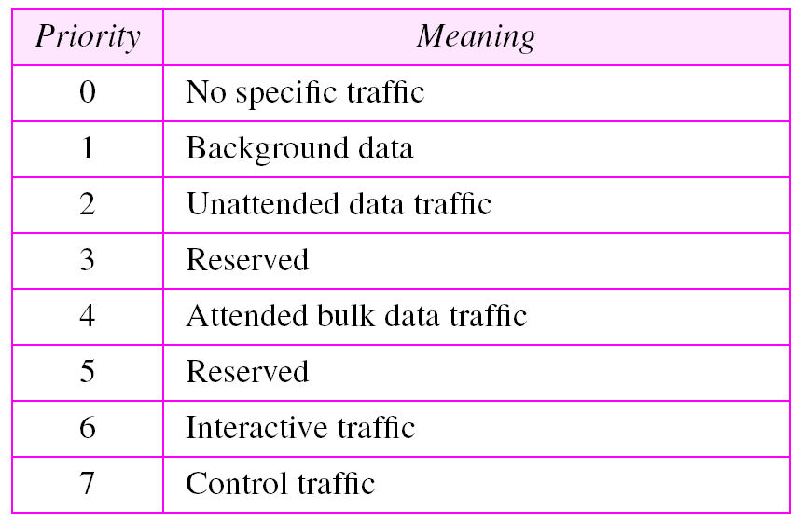
Table 27.3 Priorities for congestion-controlled
traffic

Slide 22
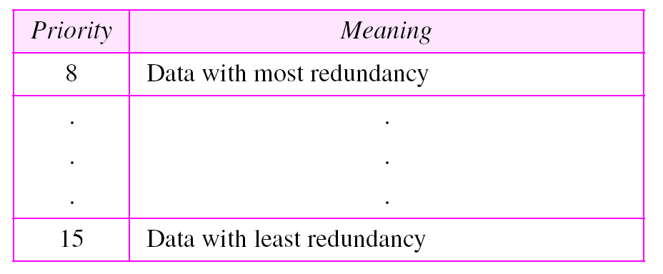
Table 27.4 Priorities for noncongestion-controlled
traffic

Slide 23
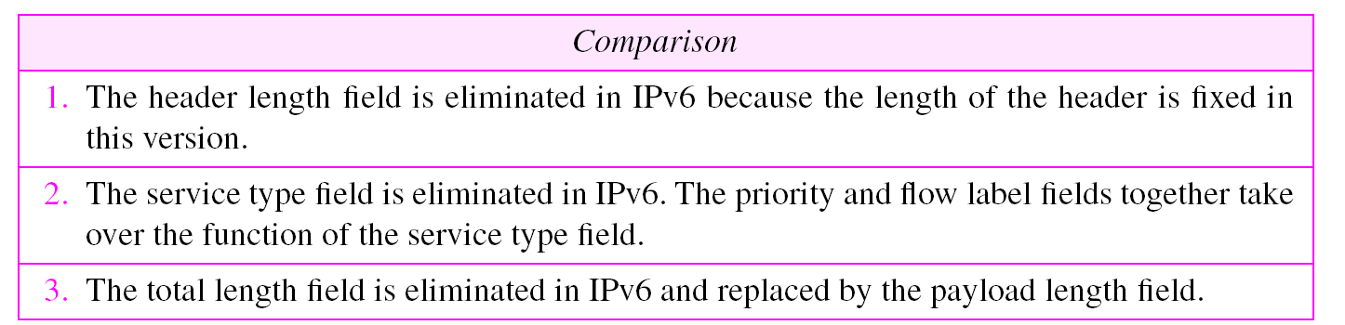
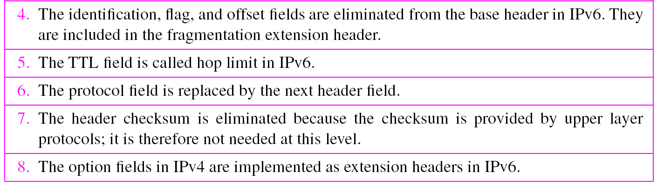
Table 27.5 Comparison between IPv4 and IPv6 packet header

Slide 24
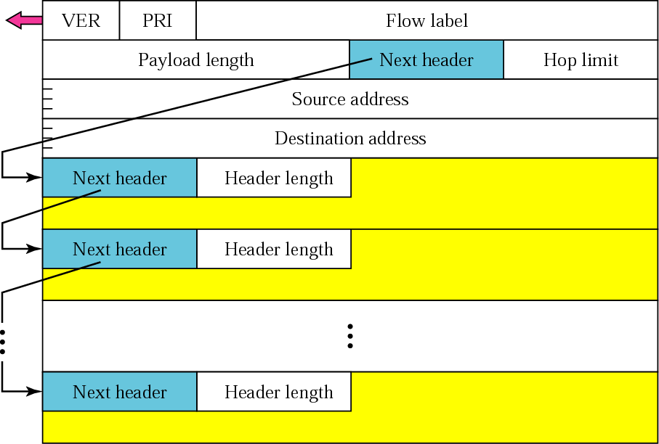
Figure 27.17 Extension header format

Slide 25
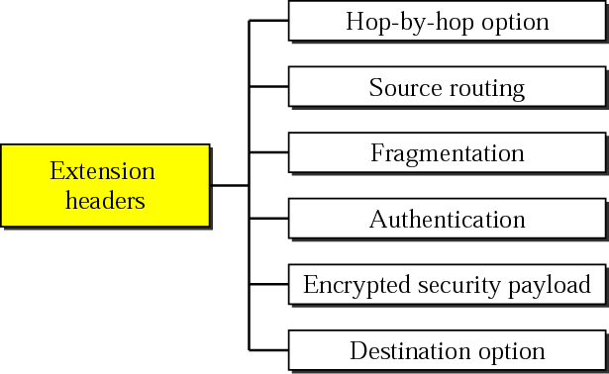
Figure 27.18 Extension header types

Slide 26

Figure 27.19 Hop-by-hop option header format

Slide 27
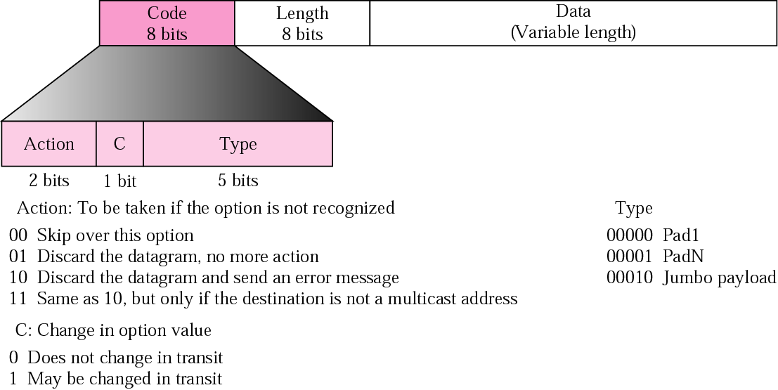
Figure 27.20 The format of options in a hop-by-hop option header

Slide 28
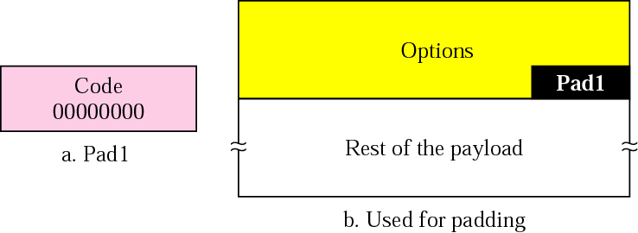
Figure 27.21 Pad1

Slide 29
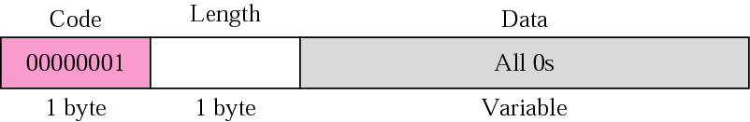
Figure 27.22 PadN

Slide 30

Figure 27.23 Jumbo payload

Slide 31
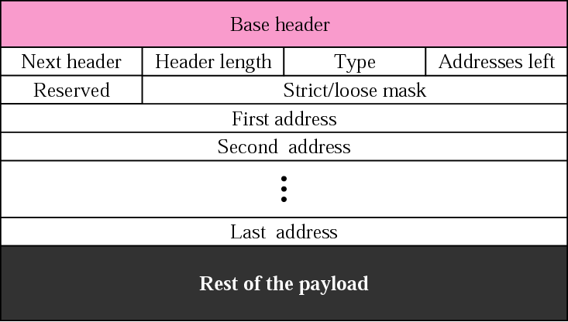
Figure 27.24 Source routing

Slide 32
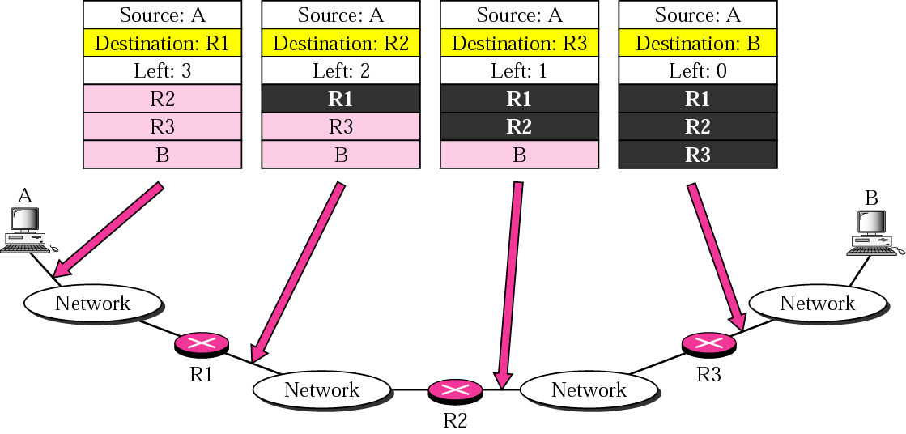
Figure 27.25 Source routing example

Slide 33
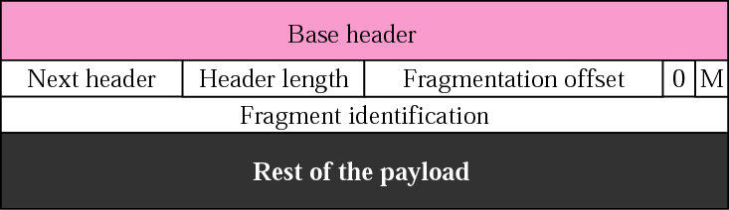
Figure 27.26 Fragmentation

Slide 34
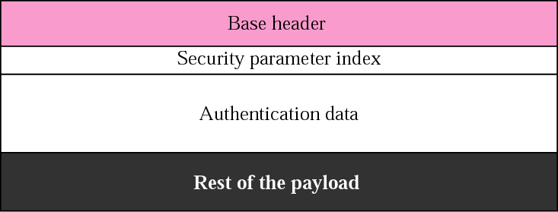
Figure 27.27 Authentication

Slide 35
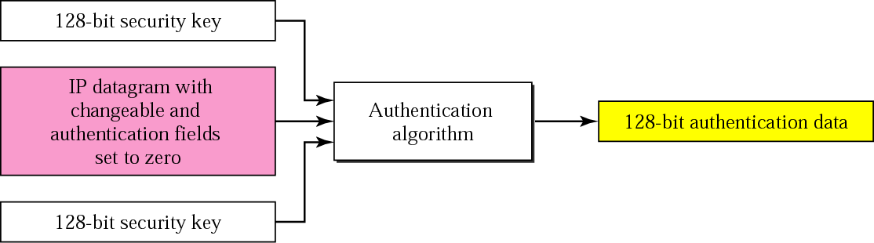
Figure 27.28 Calculation of authentication data

Slide 36

Figure 27.29 Encrypted security payload

Slide 37
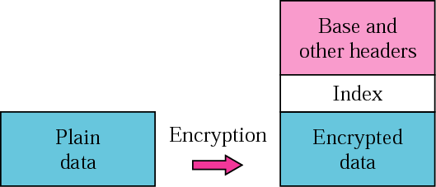
Figure 27.30 Transport mode encryption

Slide 38
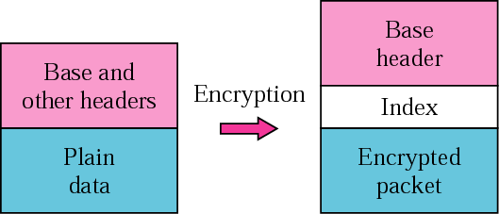
Figure 27.31 Tunnel-mode encryption

Slide 39
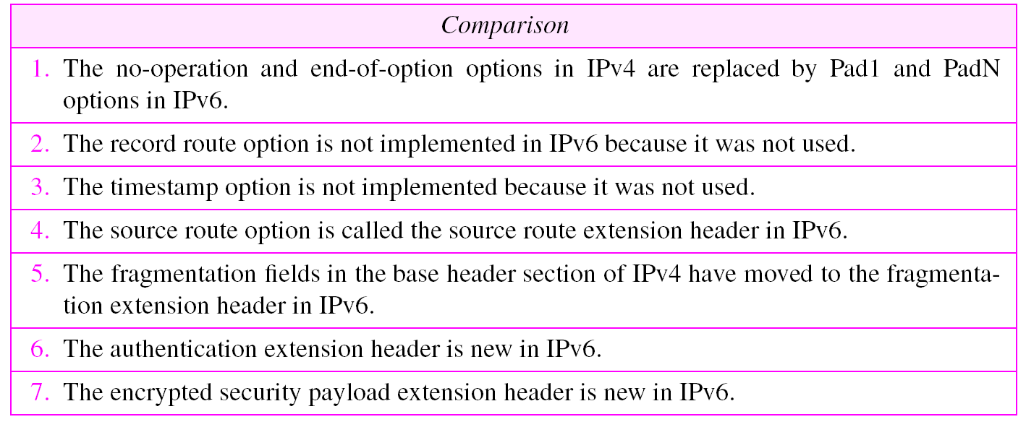
Table 27.6 Comparison between IPv4 options and IPv6 extension
headers

Slide 40
27.2 ICMPv6
ICMPv6, while similar in strategy to ICMPv4, has changes that makes it more suitable for IPv6. ICMPv6 has absorbed some protocols that were independent in version 4.
The topics discussed in this section include:
Error Reporting
Query

Slide 41
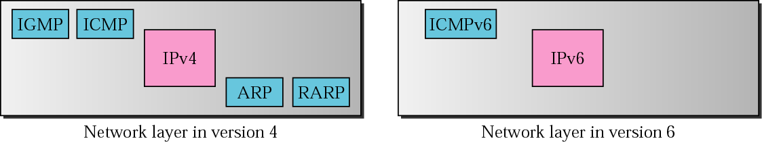
Figure 27.32 Comparison of network layers in version 4 and version 6

Slide 42
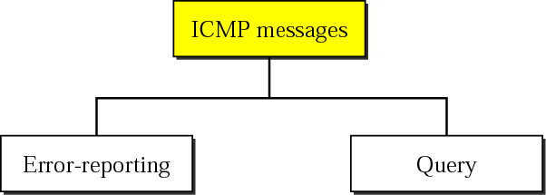
Figure 27.33 Categories of ICMPv6 messages

Slide 43
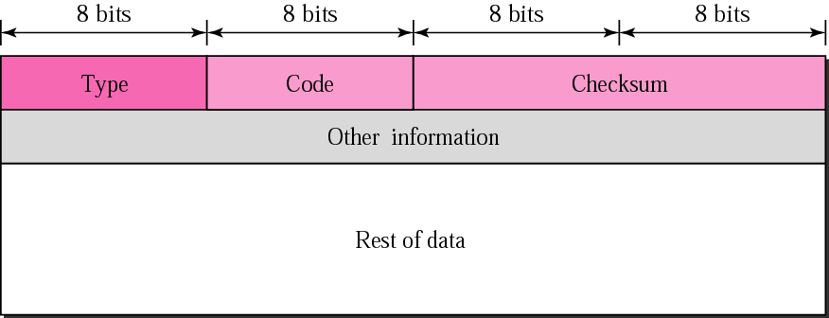
Figure 27.34 General format of ICMP messages

Slide 44
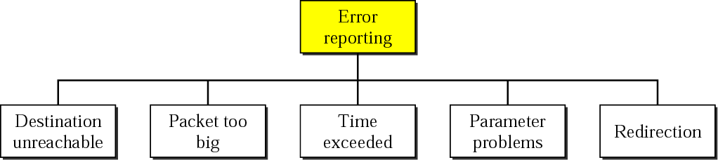
Figure 27.35 Error-reporting messages

Slide 45
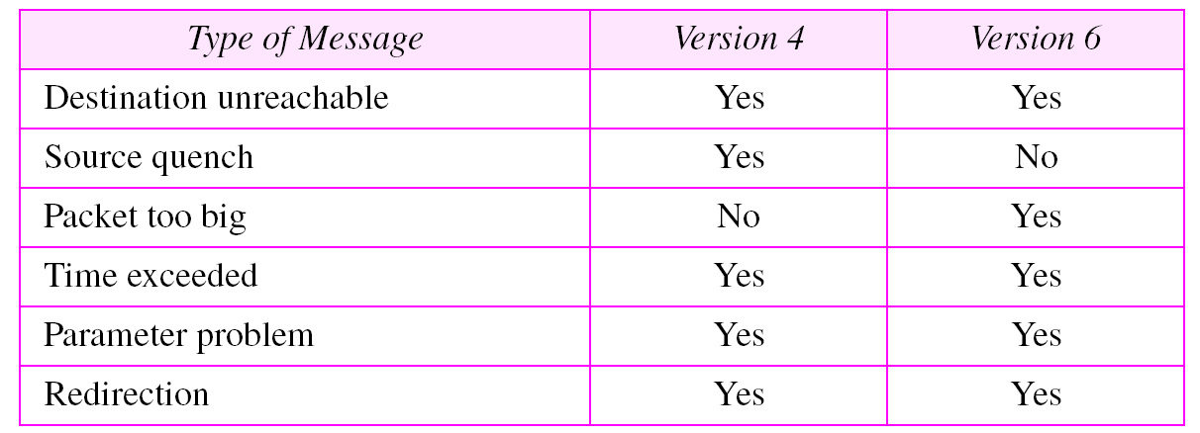
Table 27.7 Comparison of error-reporting messages in ICMPv4
and ICMPv6

Slide 46
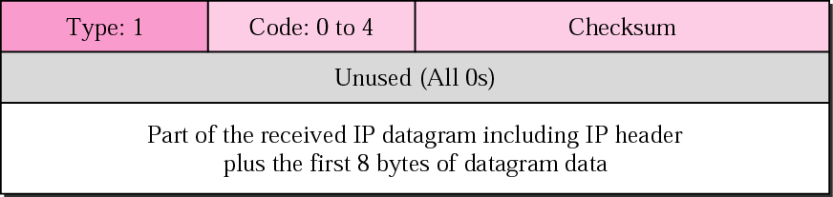
Figure 27.36 Destination-unreachable message format

Slide 47
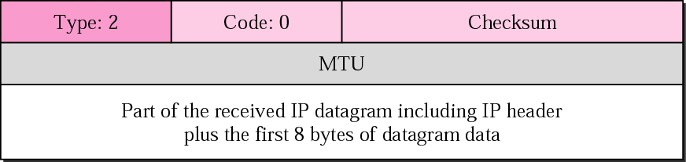
Figure 27.37 Packet-too-big message format

Slide 48

Figure 27.38 Time-exceeded message format

Slide 49

Figure 27.39 Parameter-problem message format

Slide 50
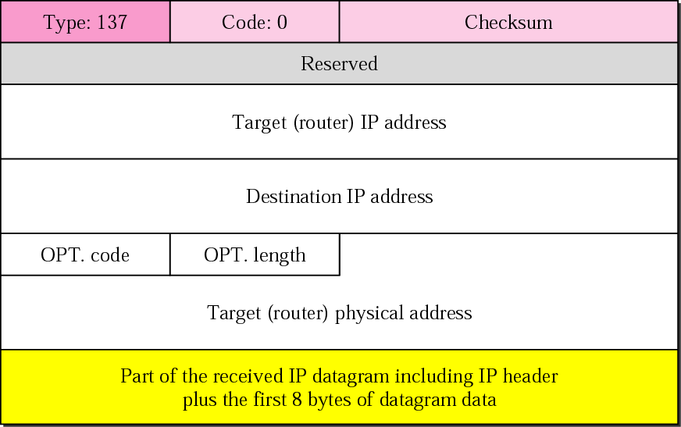
Figure 27.40 Redirection message format

Slide 51
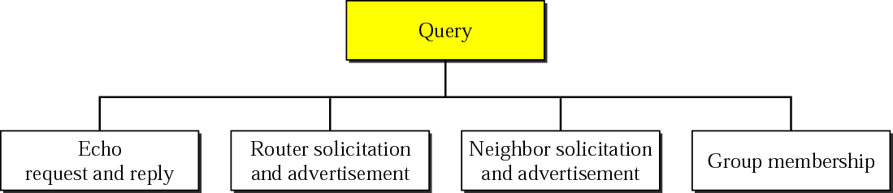
Figure 27.41 Query messages

Slide 52
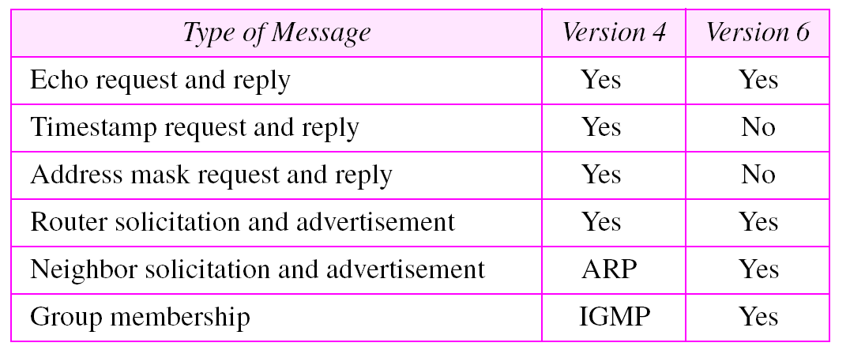
Table 27.8 Comparison of query messages in ICMPv4
and ICMPv6

Slide 53
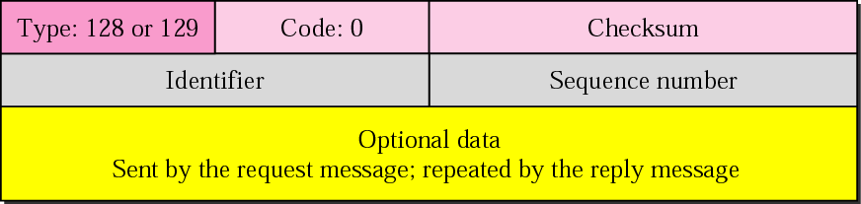
Figure 27.42 Echo request and reply messages

Slide 54
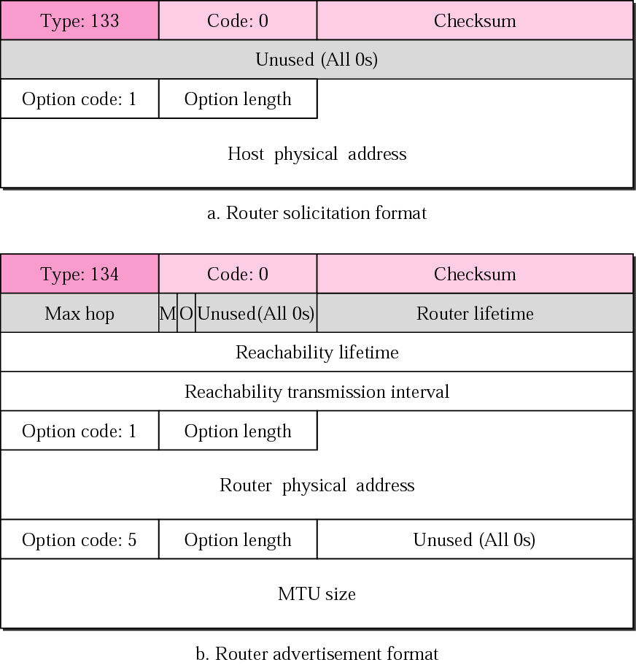
Figure 27.43 Router-solicitation and advertisement message formats

Slide 55
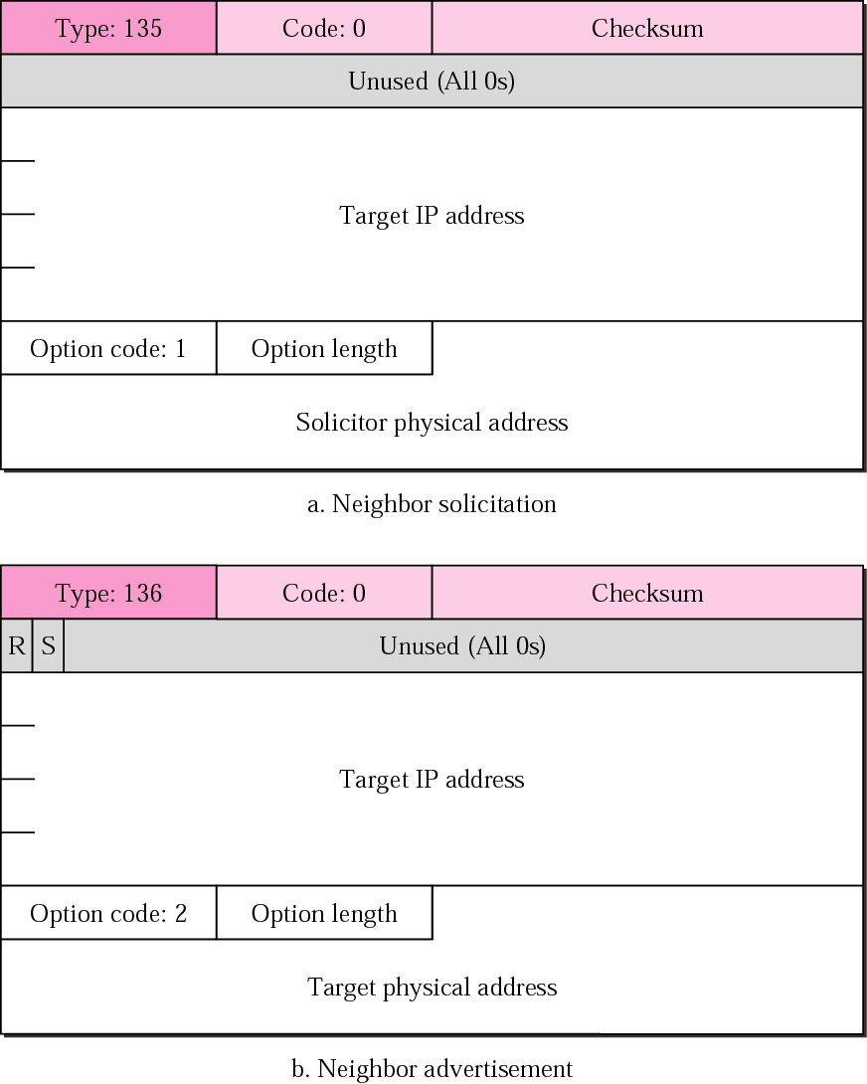
Figure 27.44 Neighbor-solicitation and advertisement message formats

Slide 56
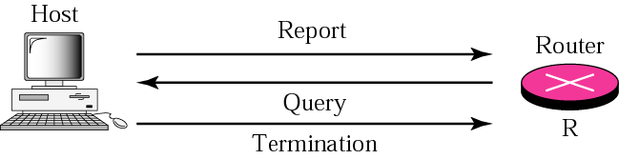
Figure 27.45 Group-membership messages

Slide 57
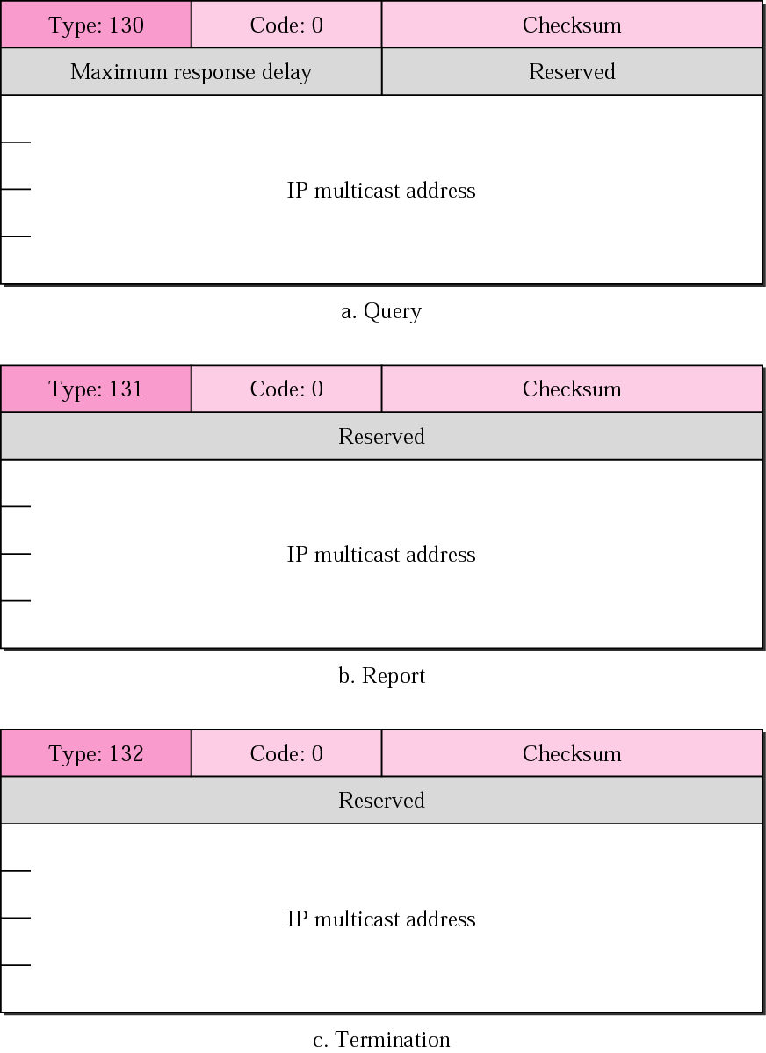
Figure 27.46 Group-membership message formats

Slide 58
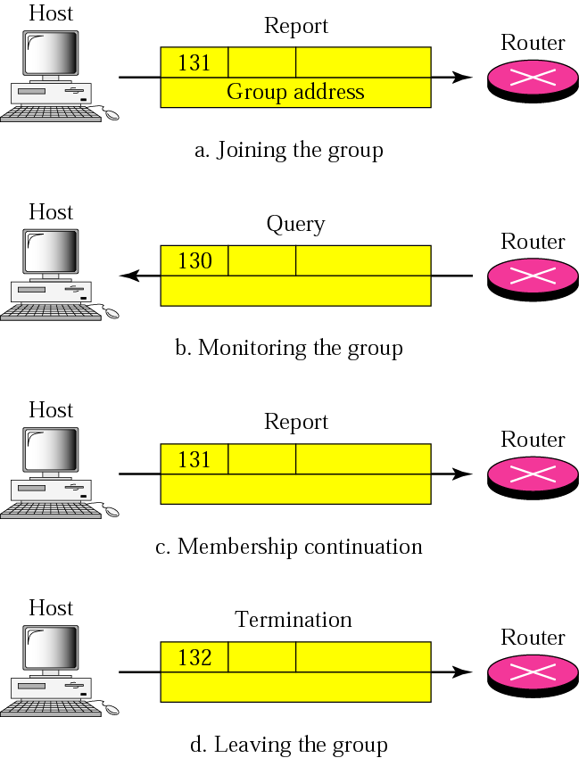
Figure 27.47 Four situations of group-membership operation

Slide 59
27.3 TRANSITION FROM IPv4
TO IPv6
Three strategies have been devised by the IETF to provide for a smooth transition from IPv4 to IPv6.
The topics discussed in this section include:
Dual Stack
Tunneling
Header Translation

Slide 60
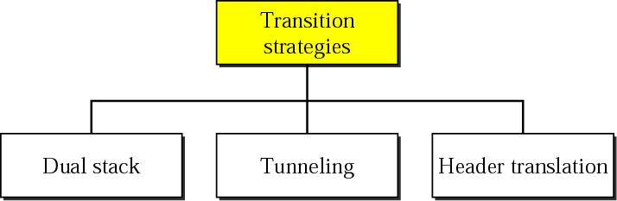
Figure 27.48 Three transition strategies

Slide 61
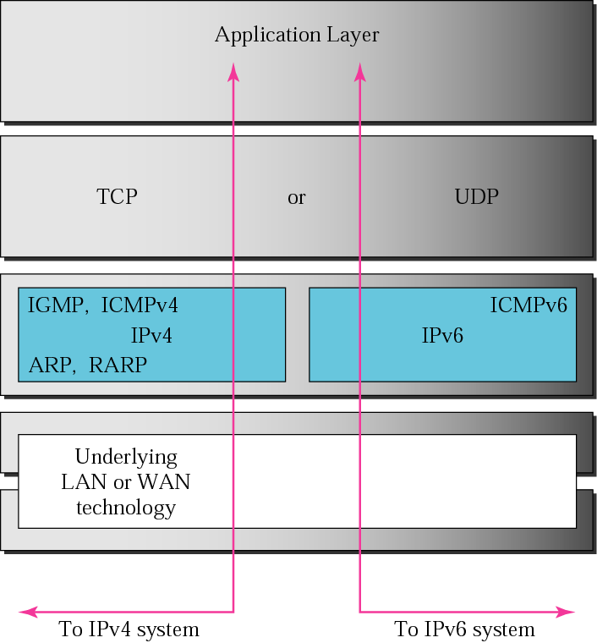
Figure 27.49 Dual stack

Slide 62

Figure 27.50 Automatic tunneling

Slide 63

Figure 27.51 Configured tunneling

Slide 64

Figure 27.52 Header translation

Slide 65

Table 27.9 Header translation

